Slide 1
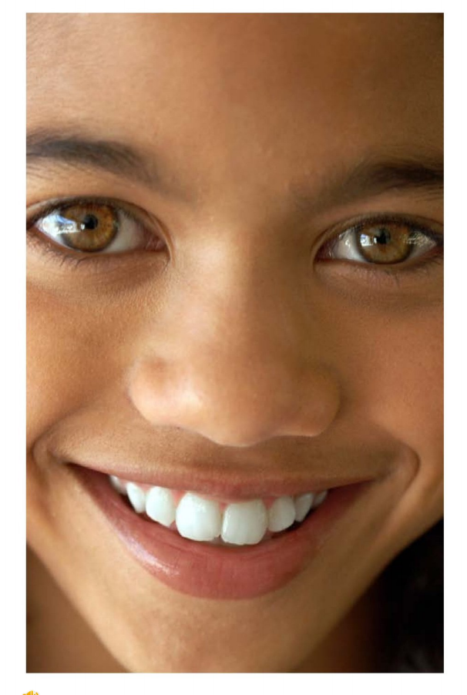
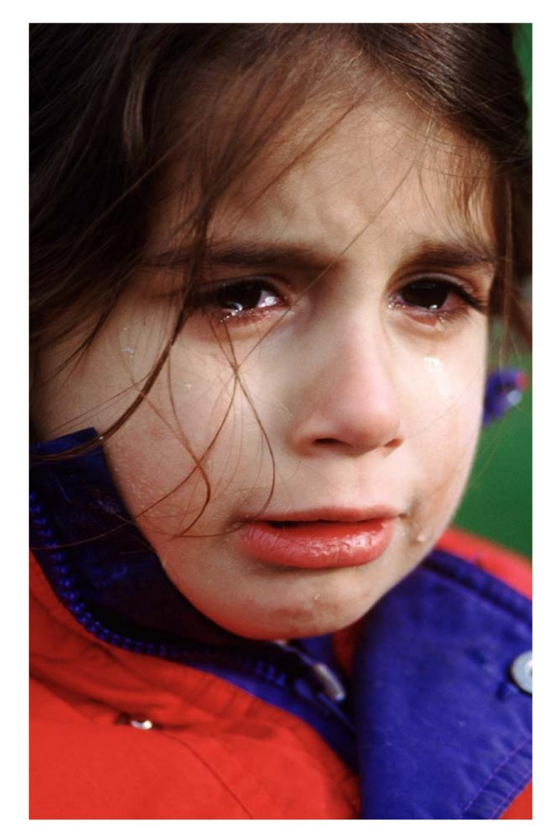
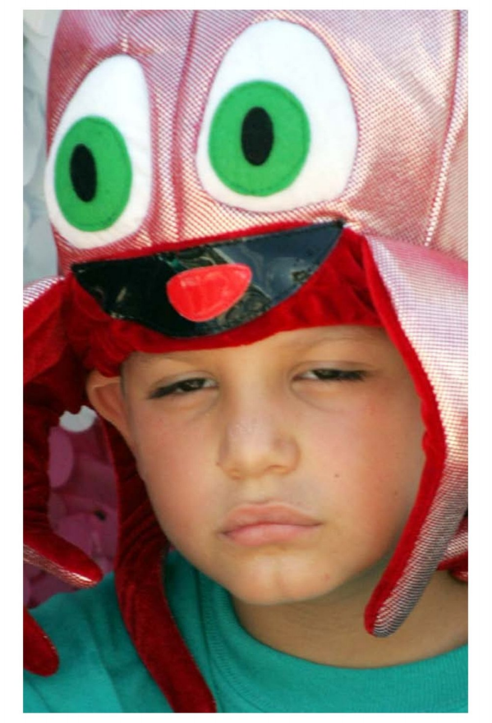
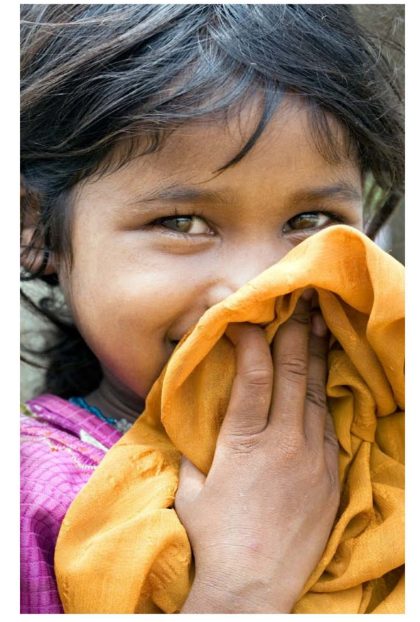
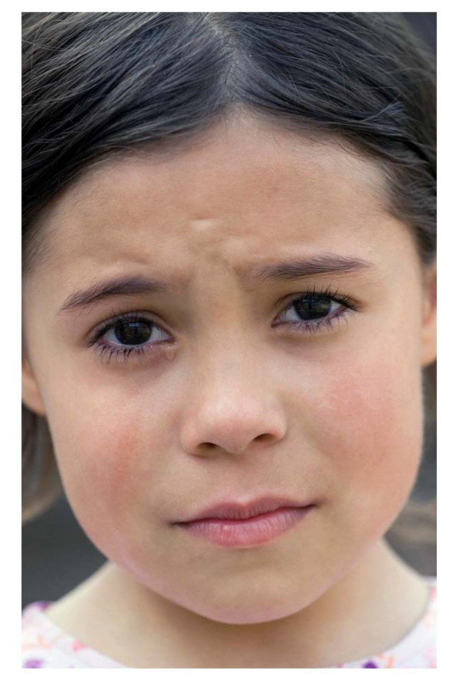
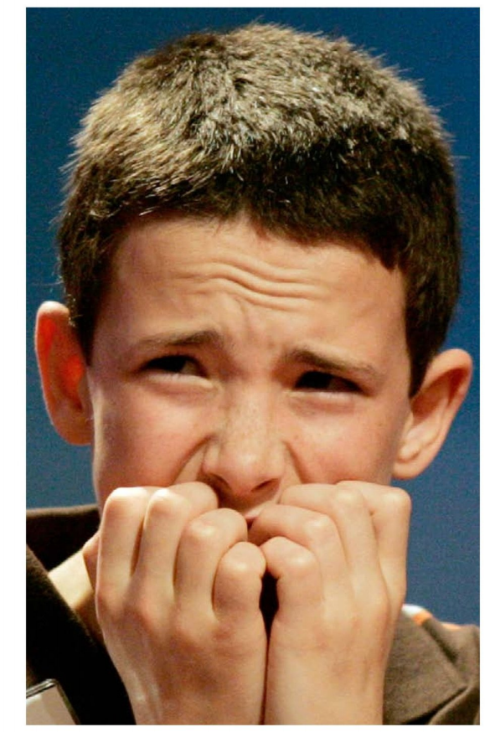
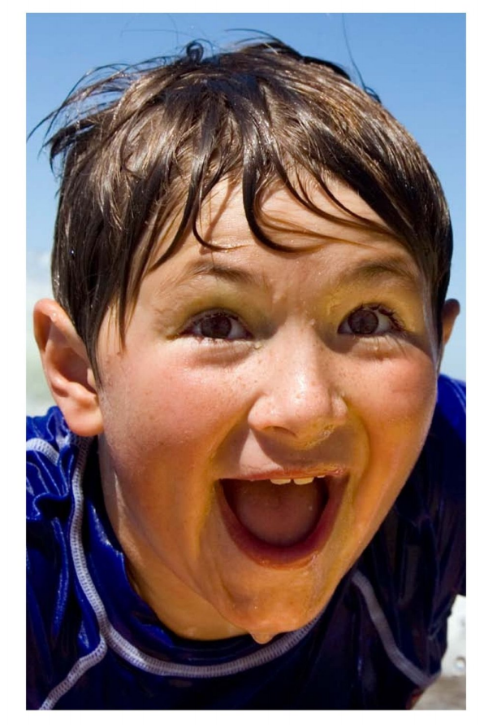
All kinds of Faces

Slide 2
Click on the colored buttons to start getting to know them!

Slide 3
This face is shy.

Slide 4
This face is sorry.

Slide 5
This face is excited.

Slide 6
This face is scared.

Slide 7
This face is sleepy.

Slide 8
This face is happy.

Slide 9
This face is sad.

